Slide 1


Slide 2
Introductions
Co-Organizers
Brian Jablonsky
Erik Noren

Slide 3
News
Follow us on Twitter: @NYCDotNetDevs
.NET 6.0 Preview 2 – https://bit.ly/2NaC0Np
.NET Core 2.1 EOS August 21, 2021 – https://bit.ly/3bFtgIg
Visual Studio 2019 for Mac v8.9 – https://bit.ly/3vaWgzD
Visual Studio 2019 v16.9 – https://bit.ly/3bBDUji
Microsoft Ignite 2021 Replay – https://bit.ly/3csqhCx
.NET Conf “Focus On Windows” Replay – https://bit.ly/3vjcwi7

Slide 4
Other NYC Meetings
TBA – NY Pluralsight Study Group “TBD” (https://www.meetup.com/NYPluralsightStudy/)
TBA – NYC Mobile .NET “TBD” (https://www.meetup.com/nycmobiledev/)
Wednesday, March 17th – NYC PowerShell Meetup “Beautiful Terminal User Interfaces with Pansies- Joel Bennett” (https://www.meetup.com/NycPowershellMeetup/)

Slide 5
.NET Virtual User Group
https://dotnetfoundation.org/community/virtual-user-group
Attend another .NET User Group virtually!
Constantly adding new user group meetings
Replay some of the meetings you might have missed

Slide 6
Upcoming Meetings
Thursday, April 8th – TBA
Thursday, May 13th – TBA
Thursday, June 10th – TBA
Thursday, July 8th – TBA
Thursday, August 12th – TBA
Thursday, September 9th – TBA

Slide 7
Announcements
Call for presentations!
Have an idea/topic for a presentation?
Want to give a presentation?
Contact Erik (erik@nycdotnetdevs.com) or Brian (brian@nycdotnetdevs.com), or tweet @NYCDotNetDevs

Slide 8
Announcements
State of User Group Survey
We’ll be sending out a survey via Meetup to gauge your interest in what you want to see from the user group
Submit your survey anonymously, or add an email address and be entered to win some prizes ($25 Amazon gift cards, .NET merch, JetBrains licenses, etc)

Slide 9

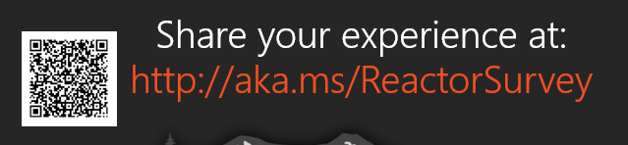
Sponsors
Microsoft Reactor http://microsoftreactor.com
Microsoft Reactors are developer community hubs providing technical events, community networking, and collaboration. They are graciously sponsoring our group in 2019 by providing our meeting space and food! Please fill out the survey at the end of the meeting!

Slide 10

Sponsors
PostSharp http://www.postsharp.net/
PostSharp is a compiler extension that adds support for patterns to C# and VB. If you’re tired of writing repetitive code, you may want to check it out. It can help you add logging, caching or INotifyPropertyChanged to your codebase without boilerplate, or solve multithreading issues.

Slide 11

Sponsors
RevDeBug https://revdebug.com
RevDeBug allows you to inspect past application state and performance profile, even directly from production environments. Trace the root cause of bugs in a matter of seconds, saving your developers' time and sanity.

Slide 12

Sponsors
JetBrains https://jetbrains.com
For over 15 years, JetBrains has strived to make the strongest, most effective developer tools on earth. By automating routine checks and corrections, JetBrains tools speed up production, freeing developers to grow, discover and create.

Slide 13
After Meeting Raffle
We have a 2 JetBrains licenses to be given away at the end of the meeting so stick around!

Slide 14

Marc Cenedella
https://twitter.com/cenedella
Founder of Leet Resumes and Ladders
Best selling author
Founding Organizer of iOSoho, New York's largest iOS Meetup

Slide 15

Reactor NYC
@MSFTReactor
#ReactorNYC
How was your Meeting?

Slide 16

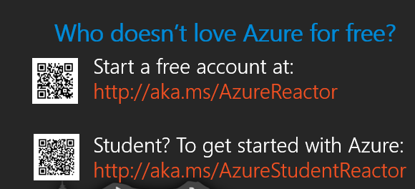

Reactor NYC
@MSFTReactor
#ReactorNYC

